Slide 1

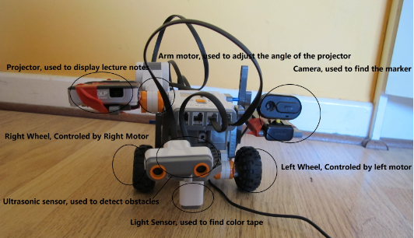
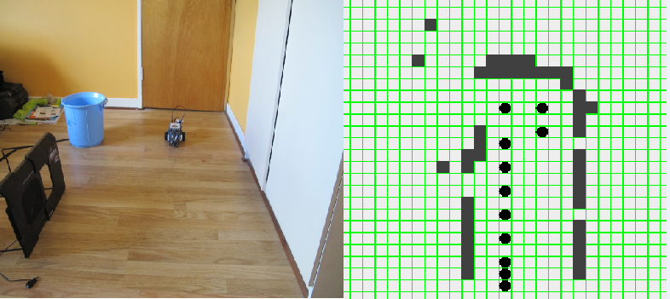
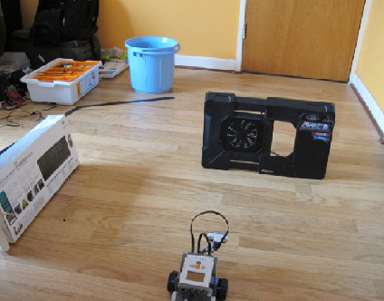
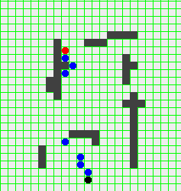
Robotic Lecturing Assistant
School of computing
Project Description
Build a robot that can build a map of one storey of the school, find a path to the specific classroom, find the whiteboard in the room and project lecture nodes on the whiteboard.
Student
Jinwu Li

